Slide 1

Telecom Customer Churn Analysis
By :
A.Hashritha
Batch - 502

Slide 2
About Me :
Background :
Btech(Computer Science Engineering)
Why you want to learn Data Science :
I want to learn Data Science because it helps turn raw data into meaningful insights that support better decision-making
Any work experience :
Fresher
Share your LinkedIn and GitHub profile URLs :
LinkdIn : https://www.linkedin.com/in/anneboina-hashritha-71295723b
GitHub : https://github.com/Hashritha3119

Slide 3
Contents :
Business Problem
Project Overview
Dataset Overview
Data Cleaning & Preparation
DAX Measures
Dashboards
Key Insights
Conclusion
Business Recommendations

Slide 4
Business Problem :
The company is experiencing a high rate of customer churn, leading to revenue loss and reduced customer lifetime value. However, it lacks clear insights into the factors driving churn and is unable to effectively identify and retain at-risk customers.

Slide 5
Project Overview :
Customer churn refers to customers leaving a service
This project analyzes customer data to identify churn patterns
Reduce churn and improve customer retention
Built using Power BI for visualization and insights

Slide 6
Data Overview :
The dataset contains customer information from a telecom company.
It includes:
Includes customer demographics
Tenure
Monthly and Total charges
Churn status
Contract and Billing

Slide 7
Data Cleaning & Transformation :
Steps :
Checked and corrected Data types
Handled missing values in Total Charges
Created New categorical Colunms and Measure
Created clean structure for Power BI visual
Created new columns such as:
Churn Status
Customer Segments

Slide 8
DAX Measures:
Major measures include:
Total Customers
Churned Customers
Churn Rate
Average Monthly Charges
Average Tenure
Revenue Lost Due to Churn

Slide 9
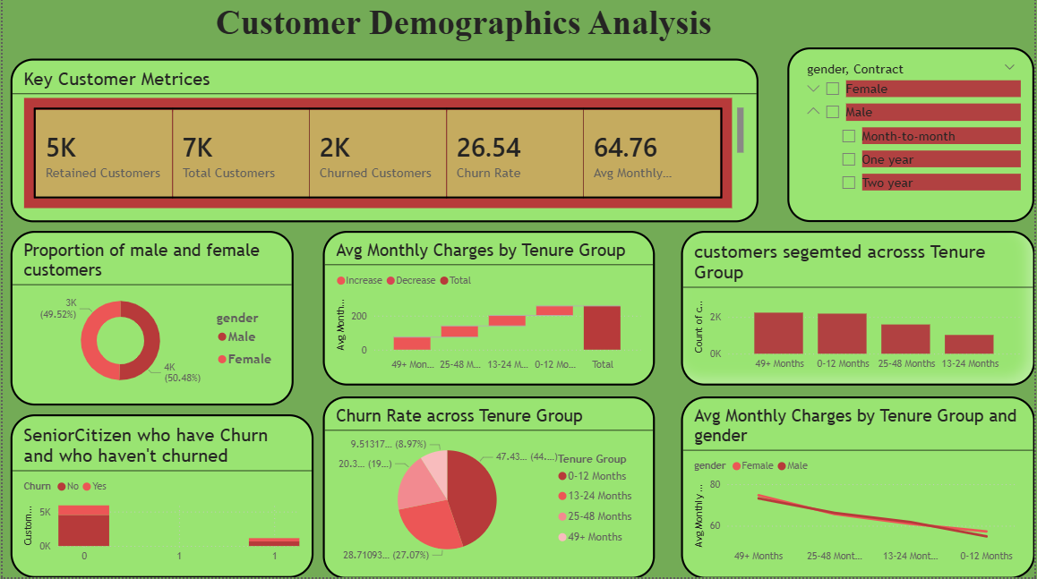
DashBoard 1: Customer Demographics Analysis

Slide 10
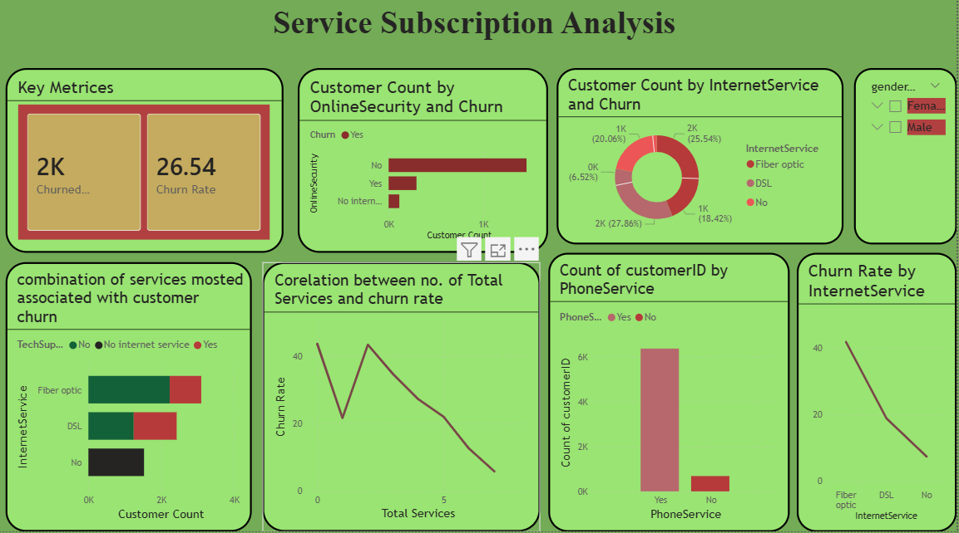
DashBoard 2: Service Subscription Analysis

Slide 11
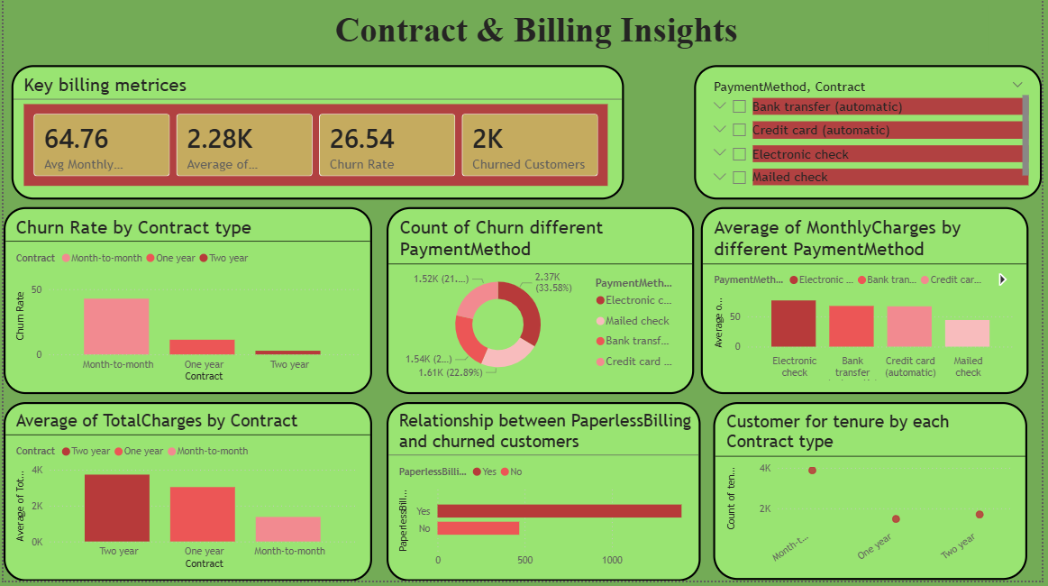
DashBoard 3: Contract & Billing Insights

Slide 12
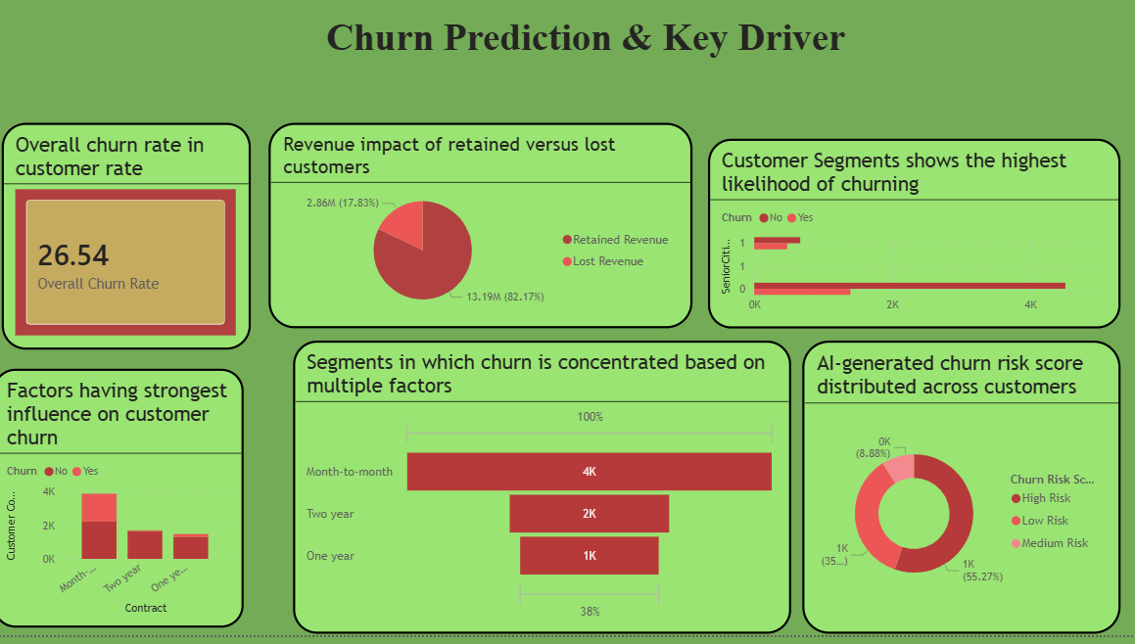
DashBoard 4: Churn Prediction & Key Driver

Slide 13
Key Insights:
Total Customers Analyzed: 7043
Churned Customers: 1869
Overall Churn Rate: 26.5%
Average Monthly Charges: 64.76
42% churn rate observed among month-to-month contract customers
Nearly 70% of churned customers were fiber optic users
Customers with tenure less than 12 months showed the highest churn tendency
Customers without Tech Support and Online Security services were more likely to churn

Slide 14
Conclusion:
Customer churn is a critical issue that directly impacts business revenue and growth.
The analysis identified key factors influencing churn, such as contract type, tenure, and monthly charges.
Customers with short-term contracts and higher charges are more likely to churn.
New customers show a higher tendency to leave compared to long-term customers.
Using Power BI, meaningful insights were generated through interactive visualizations.
These insights can help businesses take data-driven actions to improve customer retention.

Slide 15
Business Recommendations :
Improve onboarding experience for new customers to reduce early churn.
Improve fiber optic service quality and customer support.
Encourage customers to move from month-to-month plans to long-term contracts through discounts and offers.
Identify high-risk customers early and provide personalized retention offers.

Slide 16


Slide 17

THANK YOU

